Slide 1

Agri-vision: Plant Diseases Classification & Detection
Group 2 Members:
Akash Patel (101589687)
Bishakha (101547832)
Dhruv Jayal (101503569)
Muhammad Javaid Ahmed (101580538)
Pratham Sanjay Sapra (101572630)
Shreya Lingwal (101583877)
Advanced Applied Mathematical Concepts for Deep Learning

Slide 2

Introduction &
Dataset Exploration

Slide 3


Slide 4

Data Preprocessing

Slide 5


Slide 6
Model Development
& Training

Slide 7


Slide 8
Evaluation & Comparisons

Slide 9
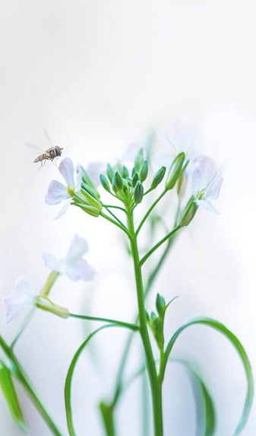

Slide 10
Classification & Detection on Unknown Data

Slide 11


Slide 12
Streamlit App Deployment

Slide 13


Slide 14
Lessons Learned

Slide 15
Group 2 - Lessons Learned
Sr No. | Name | Student Id | Topics | Lessons Learned
1 | Dhruv Jayal | 101503569 | Introduction & Dataset Exploration
2 | Akash Patel | 101589687 | Data Preprocessing
3 | Muhammad Javaid Ahmed | 101580538 | Model Development & Training
4 | Shreya Lingwal | 101583877 | Evaluation & Comparisons
5 | Bishakha | 101547832 | Classification & Detection
6 | Pratham Sanjay Sapra | 101572630 | Streamlit App Deployment

Slide 16
THE END

